Slide 1

Helping or Hindering?
How Browser Extensions Undermine
Security

Slide 2
INDEX
Introduction
Background And Related Work
Research Methodology
Chrome Extension Analysis
Disclosure & Necessity For Modifications
Security Impact Of Alterations
Discussion
Conclusion

Slide 3

Introduction
A browser extension is a small software module for customizing a web browser.
Impact of Browser Extensions on Web Security
Tampering the HTTP header
Disabling well-configured security mechanisms
Data Theft, Ad Injection and History Sniffing
How to mitigate this research gap?
An automated pipeline is introduced to detect browser extensions that modify security headers in web applications.

Slide 4
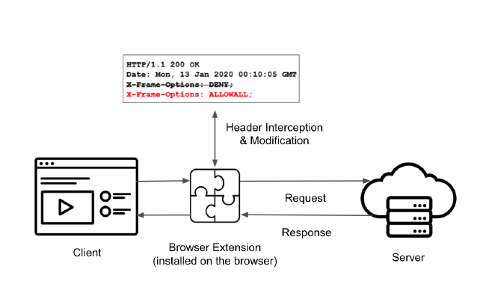

Background and Related Work
Security-related Response Headers
Content-Security Policy (CSP)
HTTP Strict-Transport-Security (HSTS)
X-Frame-Options (XFO)
X-Content-Type-Options
Cross-Origin Resource Sharing (CORS)
Set-Cookie

Slide 5
Background and Related Work
Security-related Request Headers
Referrer and Origin
Fetch Metadata
upgrade-insecure-requests

Slide 6
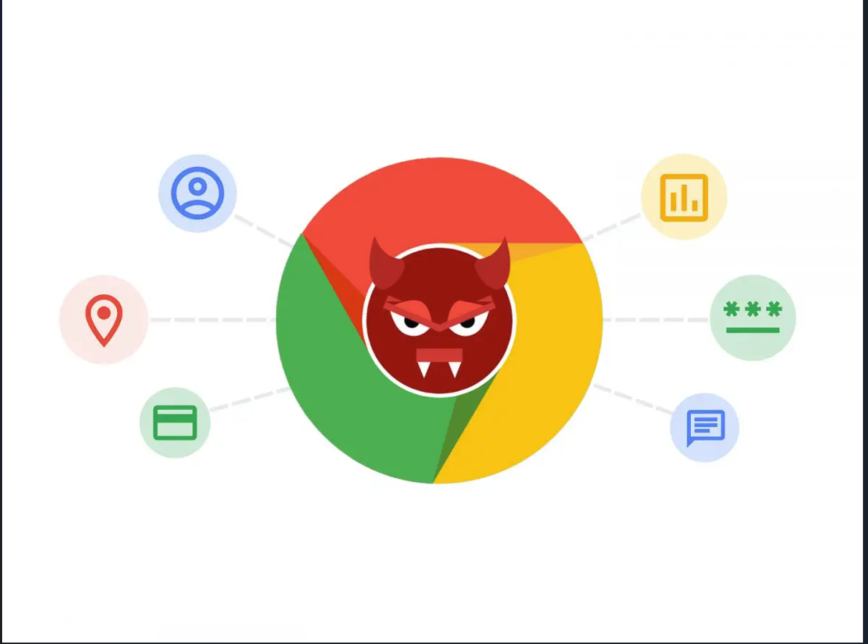
Background and Related Work
Related Work
Malicious Browser Extensions
Vulnerable Browser Extensions
Header Interference by Extensions

Slide 7
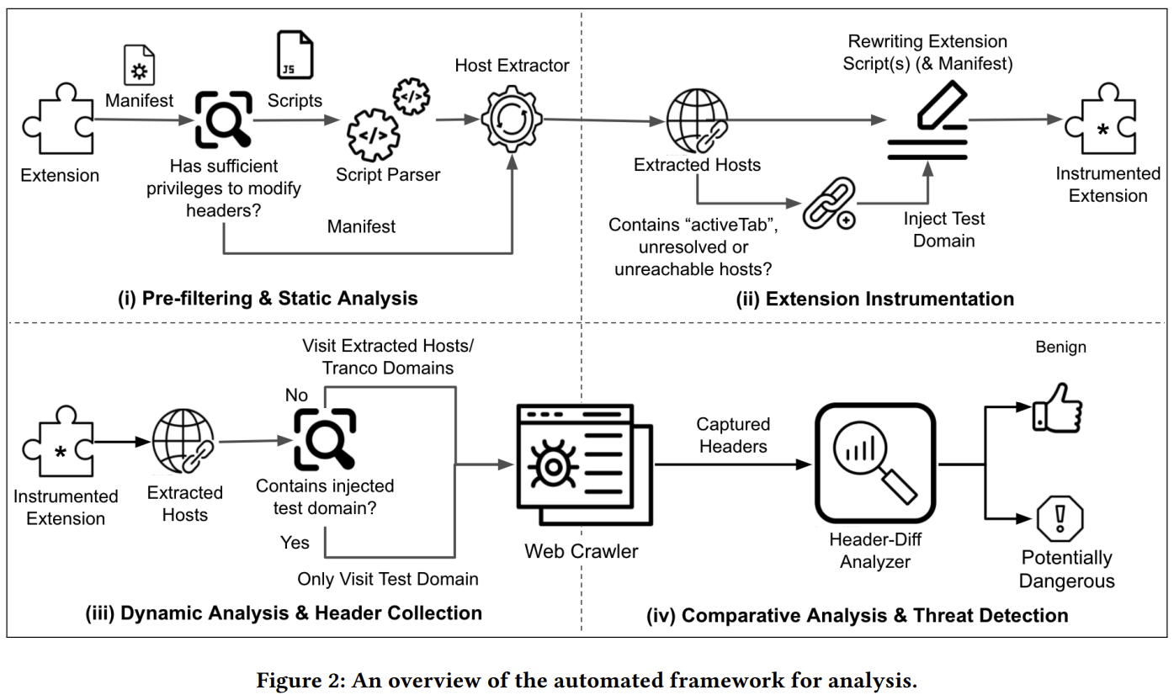
Research Methodology
Extension Analysis
Extension Instrumentation
URL Scheduling & Header Collection
Detecting Potentially Harmful Extensions
Notes:
Moving on to the research methodology The authors have developed an automated framework to detect browser extensions that modify HTTP headers, which can potentially pose security risks to users. The framework is designed to answer fundamental questions such as how many extensions modify headers, how many actively inject, drop, or overwrite security-related headers, and which headers are most frequently altered. To accomplish this, the framework has 4 stages, as shown here, we have ,Extension Analysis, Extension Instrumentation, URL Scheduling and Header Collection , Detection of Potentially harmful extensions.
first parses the manifest and scripts of downloaded extensions to identify those that have the ability to modify headers. It then instruments these extensions to capture header changes during runtime and stores the original and modified sets of headers. Finally, the framework analyzes the captured modifications to identify potentially dangerous ones.
The aim of this framework is to identify extensions that pose security risks to users and to understand how these risks change over time. The authors hope that their framework will aid in enhancing the security of browser extensions and the Web as a whole.

Slide 8
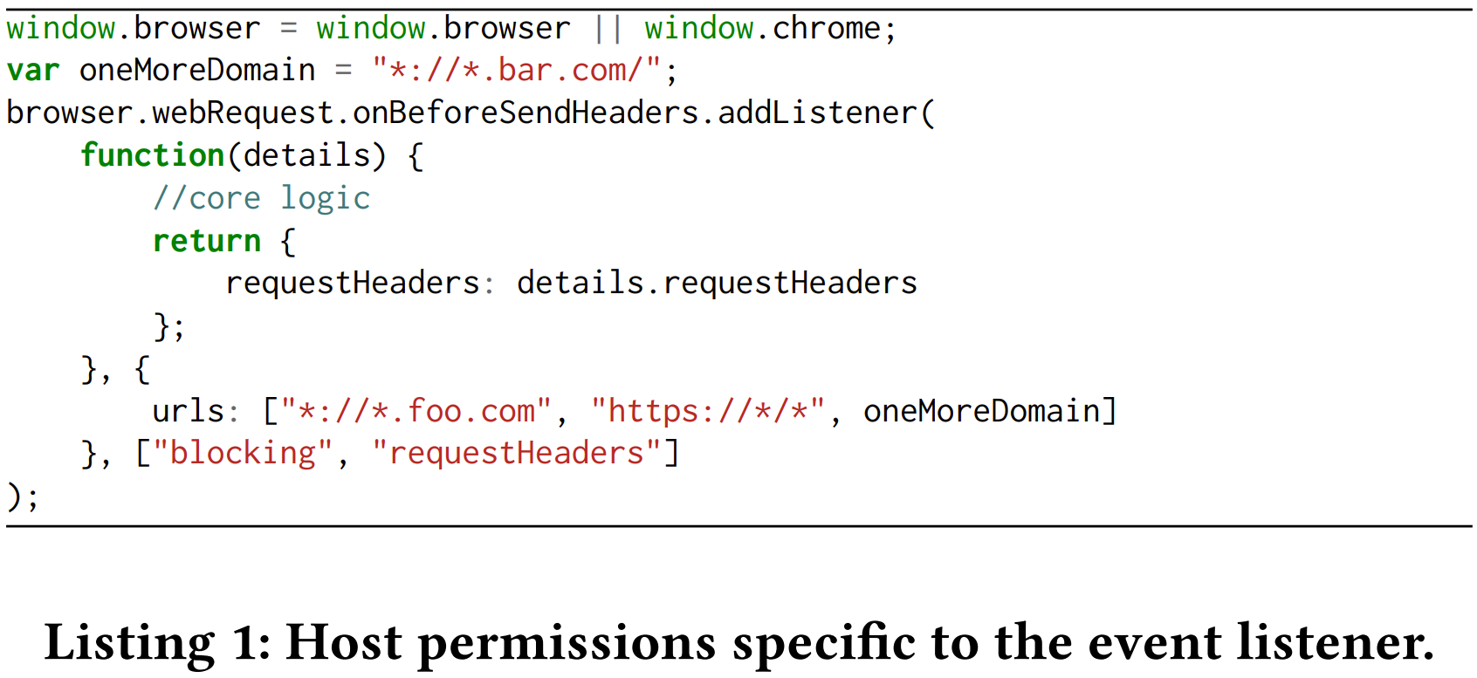
Extension Analysis
‘webRequest’ and ‘webRequestBlocking’
Host permission
'activeTab’ privilege
Extracting target hosts works where dynamic analysis fails
Notes:
Extension Analysis - In this phase the framework uses a static analysis approach to identify extensions that can potentially intercept client-server exchanges.
The static analyzer is lightweight component and extracts only literal values from the target APIs.
An extension needs to have both webRequest and webRequestBlocking permission to intercept and modify request and response headers at runtime.
The extension must also request host permission to operate on specific domains.
The framework extracts URLs/hosts for analysis from the manifest and the arguments of the webRequest APIs within the code.
The framework flags extensions with the activeTab privilege for further analysis as they can modify headers on any active tab of the browser.
The framework resorts to Tranco Top 100 domains if no hosts are extracted from the sources.

Slide 9
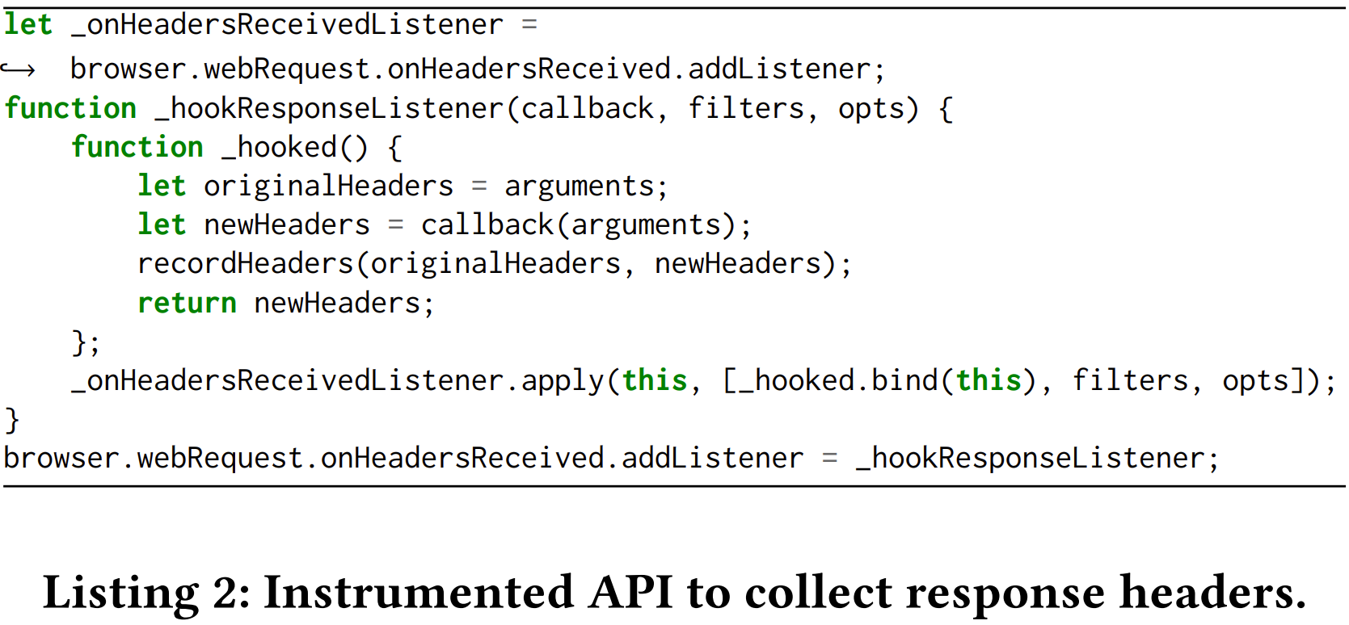
Extension Instrumentation
Overwrites the native definition of the corresponding webRequest
Captures both original headers an their modified counterparts
onHeadersReceived.addListener is modified
Notes:
The framework overwrites the native definition of webRequest APIs within the extension-space to enable header-capturing mechanisms
It captures both the orignal headers and their modified counterparts as well
In this snippet we can see the framework recording the headers before being passed on the browser API extensions

Slide 10
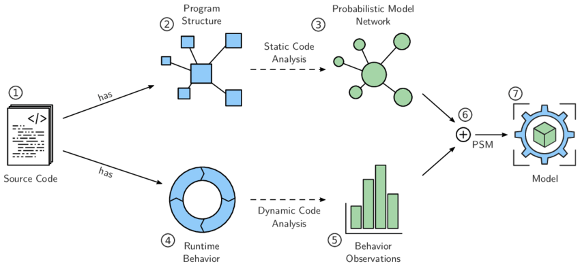
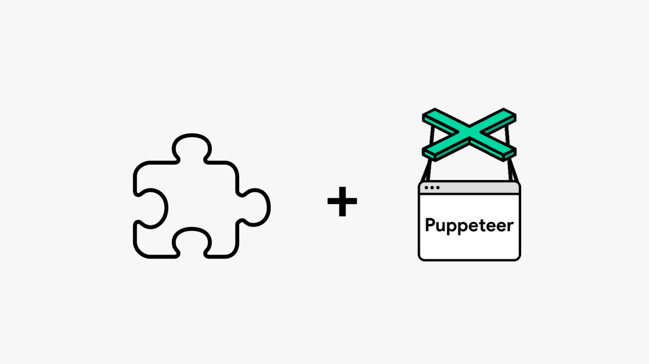
URL Scheduling & Header Collection
Dynamic Analysis
We load instrumented extensions separately in the browser and visit each of the corresponding hosts
Puppeteer
Chrome extension to load the other extensions and launch browser instances
Notes:
The dynamic analysis stage of the approach involves loading instrumented extensions separately in the browser and visiting corresponding hosts to capture the original and modified set of headers at runtime.
The approach is not prone to server-side randomness, which might influence the results, as it captures headers within a single visit to the site.
For each instrumented extension, the associated target hosts are visited, and for special cases, modified extensions are scheduled to run on a test domain.
Puppeteer is used to load the extensions and launch browser instances for every extension, successfully visiting each URL.
The framework stays on the page for six seconds after the page load to record client-server communication and collects the original and modified set of headers on API invocation.
The hooked target APIs relay the header data to a logging server.

Slide 11
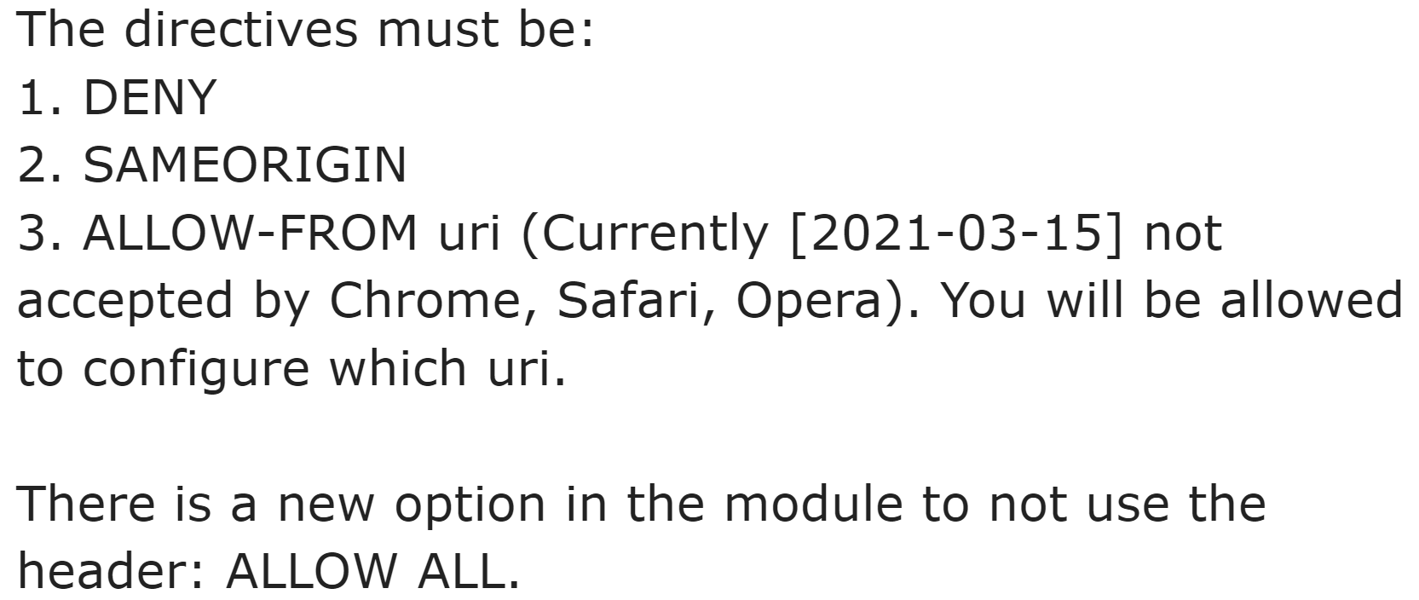
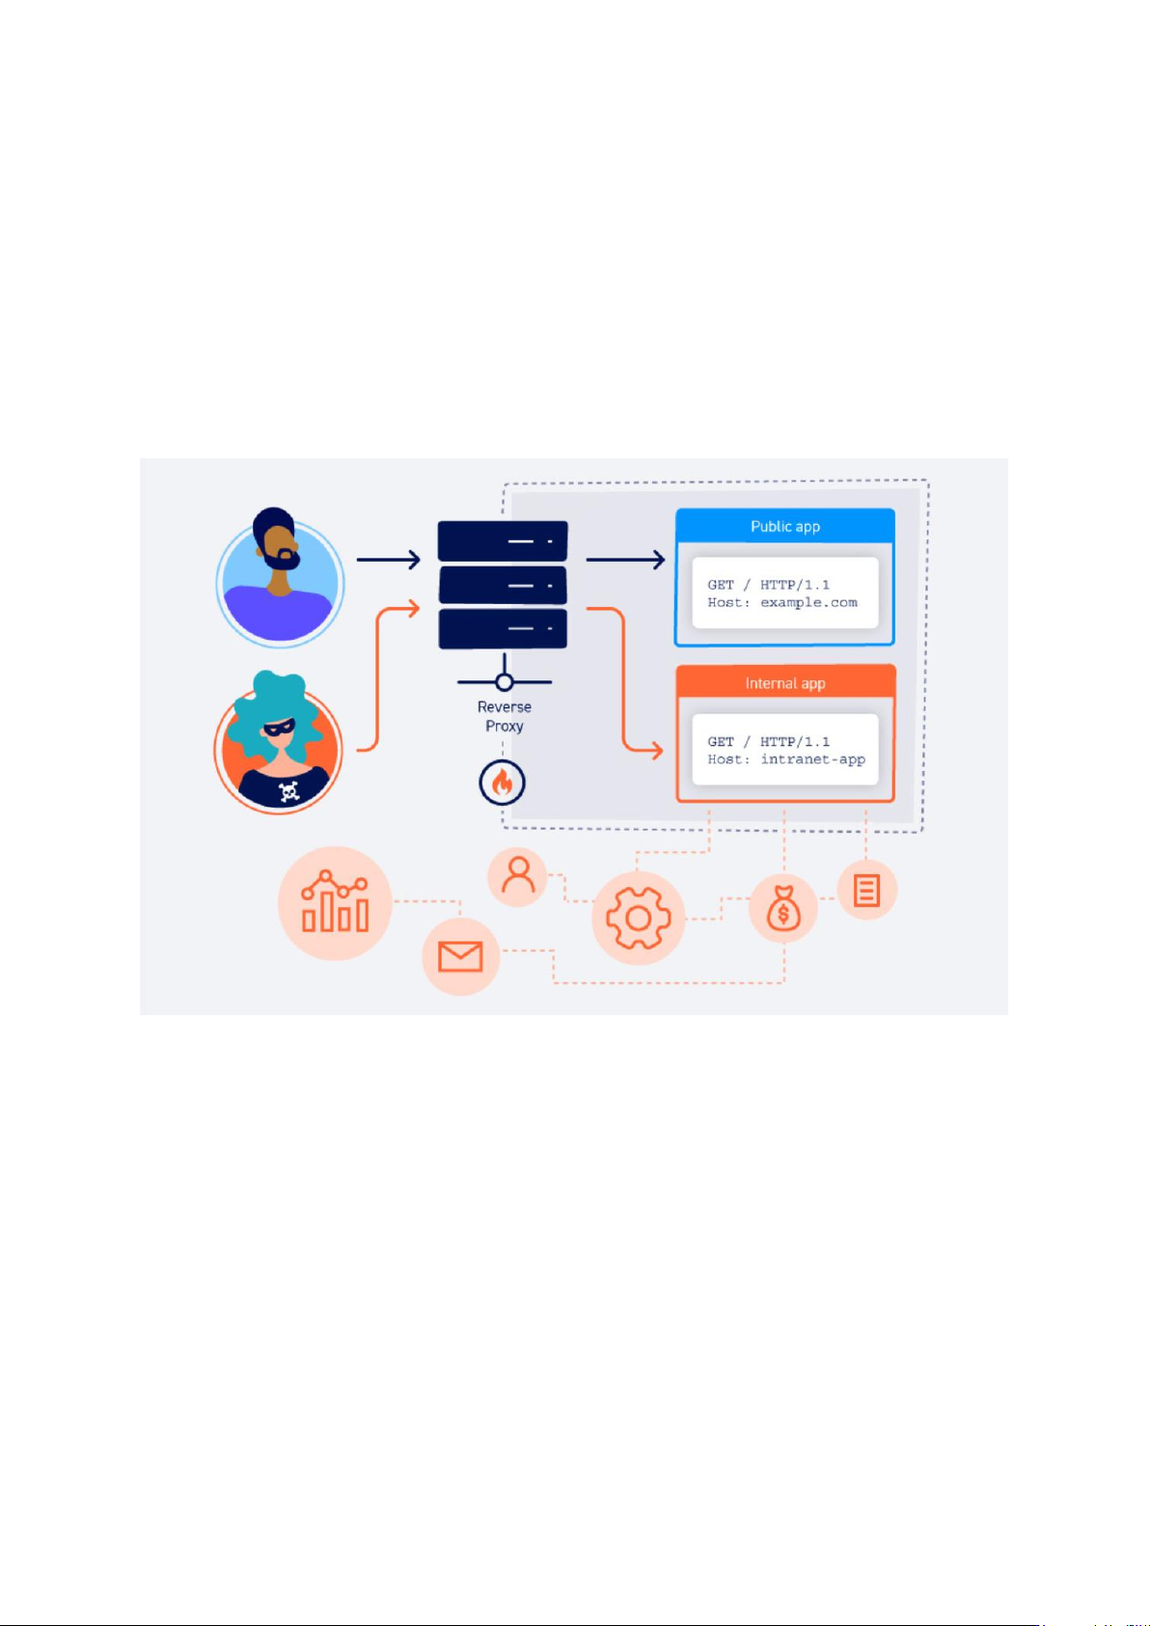
Detecting Potentially Harmful Extensions
Original and modified set of headers are compared
X-Frame-Options header
when an extension modifies the header to enforce a relaxed version of the server-sent policy, e.g., replace DENY with ALLOWALL
Identification done by framework
modifiedHeader
injectedHeader
strippedHeader
Notes:
The original and modified headers are retrieved, parsed, and compared to identify differences in their values.
The analyzer labels an extension as modifiedHeader if it modifies a security header to enforce a relaxed server-sent policy.
If an extension adds a security header with no ground-truth header, it is labeled as injectedHeader, while if it removes or replaces a ground-truth header with an empty string, it is marked strippedHeader.
The framework can be extended to analyze other headers since it collects all headers at runtime.
The framework reports whether an extension exhibits benign modifications or suspicious behavior based on the target security headers' operations.

Slide 12

Chrome Extension Analysis
Permissions & Source Code Analysis
Instrumentation Analysis
Results and Overall Impact
Temporal Evolution
Notes:
We will discuss Chrome extension analysis done by the authors. The analysis is divided into four parts. 1, 2, 3, 4. Lets discuss these in detail.

Slide 13
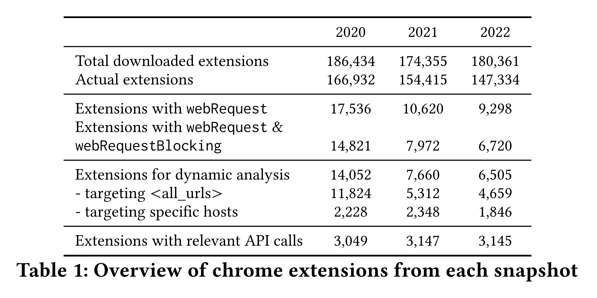
Permissions & Source Code Analysis
Extracted ‘crx’ packages from downloaded extensions and removed themes and invalid extensions.
Identified the extensions which request the webRequest privilege.
Identified extensions which hold privilege to synchronously intercept and modify HTTP headers.
Identified extensions which contain content_security_policy definitions.
Notes:
The framework extracts chrome extension packages from downloaded extensions and removes themes and invalid extensions during its screening process.
At the first stage, we identify the extensions which request the webRequest privilege to intercept headers.
At the second stage, we obtain extensions which hold the privilege to synchronously intercept and modify HTTP headers at runtime and consider them for the next stage of analysis.
At the third stage, we identify which extensions contain content_security_policy definitions. The framework then adds the remote server’s location to the connect-src directive to allow XHRs among them and, thus, header storage for further analysis.

Slide 14
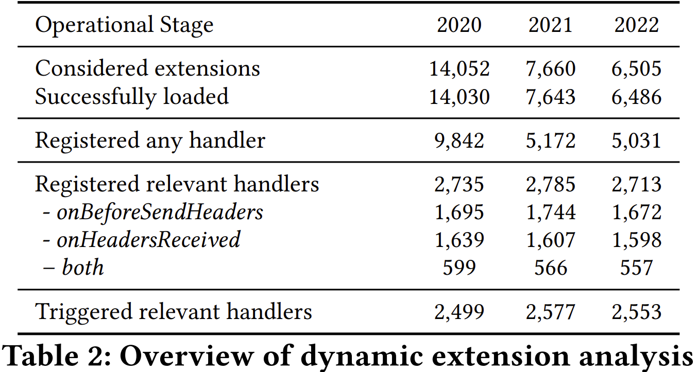
Instrumentation Analysis
The hook was successfully injected into ∼99% of the extensions at runtime, and the overwritten functionality is executed without any error.
Discrepancy primarily comes from extensions that only register these event handlers on certain conditions.
The number of extensions for which a relevant handler was triggered is also below those that registered an event handler in the first place
Notes:
The authors observed that the hook was successfully injected into ∼99% of the extensions at runtime, and the overwritten functionality was executed without any error. For the rest, 26 extensions failed to load at runtime. However, this was somewhat related to syntax errors in the original extensions across the datasets.
They focused on two webRequest APIs used by browser extensions for interception of request or response headers. The authors found a smaller number of extensions register event listeners for these APIs compared to the larger number of extensions that register at least one event listener. The discrepancy is due to extensions that only register event handlers under certain conditions.
The number of extensions triggered with a relevant handler is lower than the number of extensions that registered an event handler. The authors manually analyzed 20 extensions from each set and found that the analysis did not yield results due to technical limitations or extensions triggering functionality on certain runtime conditions. There were 151 non-triggering extensions present in all three datasets due to overlap.

Slide 15
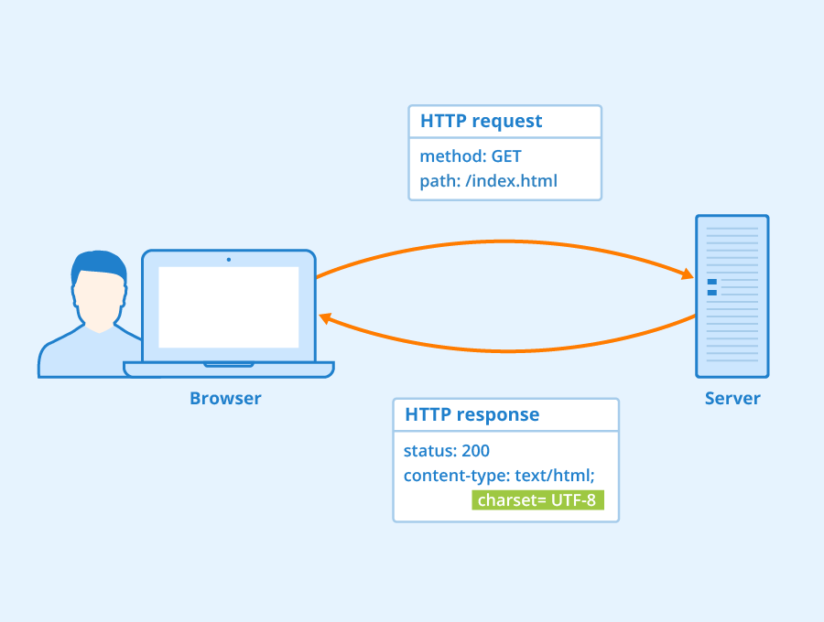
Results and Overall Impact
Response Headers
Content-Security-Policy (CSP)
X-Frame-Options (XFO)
Cross-Origin Resource Sharing (CORS)
Cookie Security Attributes
Strict-Transport-Security Header (HSTS)
Request Headers
Origin/ Referrer
Fetch metadata
Notes:
Here is an overview of the most prevalent headers and their respective modifications.
The study examines the impact of browser extensions on web security by analyzing their manipulation of request and response headers.
For response headers, extensions that altered headers in the last 3 years were analyzed. X-Frame-Options (XFO) and Content-Security-Policy (CSP) were the most affected server-sent security headers, likely due to extensions attempting to load content in frames or inject their scripts into pages. In regards to CSP, almost all directives were injected by at least one extension, with script-src and default-src being the most commonly dropped directives for XSS mitigation.
Dangerous misconfigurations for Cross-Origin Resource Sharing (CORS) can occur if Access-Control-Allow-Credentials is set to true and Access-Control-Allow-Origin is set to * for allowed origin, enabling an attack to access devices that are in the local network of the victim.
31 extensions modify SameSite flag for cookies, some disabling CSRF protection, while only 15 extensions interfere with Strict-Transport-Security header. Some examples include DuckDuckGo Privacy Essentials (5M+ users) that blocks all attempts to set cookies and Multi Chat - Messenger for Whatsapp (40K+ users) that sets SameSite=none.
A total of 315 extensions were found to interfere with security headers in requests. The Origin and Referer headers were the most commonly tampered with, particularly in recent extensions. Only two extensions negatively affected the upgrade-insecure-requests header, while interference with Fetch Metadata was not significant.

Slide 16
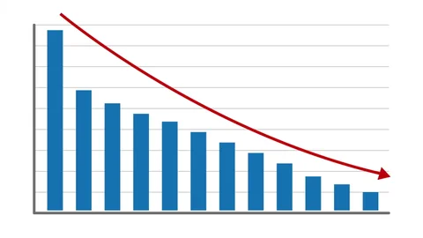
Temporal Evolution
Famous extensions also violated these ethics to modify and alter headers
DuckDuckGo
Video Downloader for Vimeo
MarkDown Viewer
Over period these were either taken down or updated
It is becoming harder to judge whether new extensions make more excessive use of interception capabilities than older ones
Notes:
This study investigates the evolution of Chrome extensions that modify security headers over 19 months. The study found that many extensions added new features that required relaxed security restrictions imposed by CSP, XFO, and ACA-Origin. A significant number of extensions were removed from the store, but the vast majority were benign, and only a few were known to be malicious. The study suggests that newly added extensions make more excessive use of interception capabilities than older ones..
Famous extensions also violated these ethics to modify and alter headers
DuckDuckGo
Video Downloader for Vimeo
MarkDown Viewer
Over period these were either taken down or they updated their code to include relevant headers
It is becoming harder to judge whether new extensions make more excessive use of interception capabilities than older ones.

Slide 17
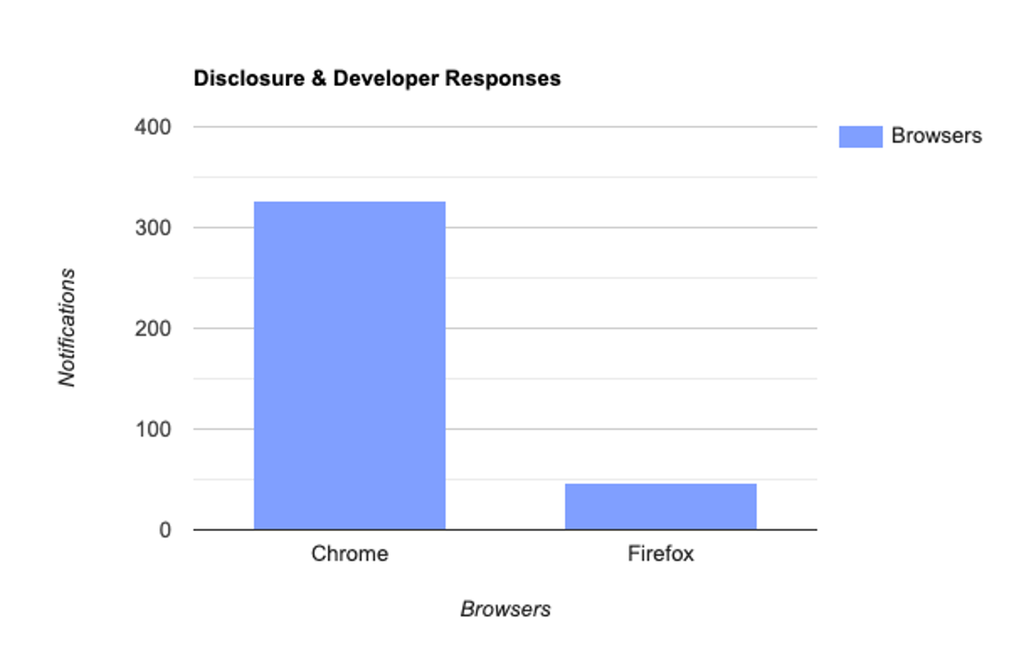
Disclosure & Necessity for Modifications
Acknowledged our report and the threat
Unaware of potential security implications
24/30 explained usage behind altering
Unidentified bug or legacy code
Notes:
This study investigates the longitudinal evolution of Chrome extensions that modify security headers over 19 months. The study found that many extensions added new features that required relaxed security restrictions imposed by CSP, XFO, and ACA-Origin. A significant number of extensions were removed from the store, but the vast majority were benign, and only a few were known to be malicious. The study suggests that newly added extensions make more excessive use of interception capabilities than older ones..
Famous extensions also violated these ethics to modify and alter headers
DuckDuckGo
Video Downloader for Vimeo
MarkDown Viewer
Over period these were either taken down or they updated their code to include relevant headers
It is becoming harder to judge whether new extensions make more excessive use of interception capabilities than older ones.

Slide 18
Disclosure & Necessity for Modifications
Manual Analysis
Manually sample and investigate 50 extension from 8 categories
Injecting scripts
Resources to highlight text
Solve Captchas
Text-based reference to 3rd party domains
Notes:
This study investigates the longitudinal evolution of Chrome extensions that modify security headers over 19 months. The study found that many extensions added new features that required relaxed security restrictions imposed by CSP, XFO, and ACA-Origin. A significant number of extensions were removed from the store, but the vast majority were benign, and only a few were known to be malicious. The study suggests that newly added extensions make more excessive use of interception capabilities than older ones..
Famous extensions also violated these ethics to modify and alter headers
DuckDuckGo
Video Downloader for Vimeo
MarkDown Viewer
Over period these were either taken down or they updated their code to include relevant headers
It is becoming harder to judge whether new extensions make more excessive use of interception capabilities than older ones.

Slide 19

Security Impact
client-side security may not be impacted with:
NoScript
AdBlocker
Privacy-preserving extensions
Multi-valued headers
Notes:
This study investigates the longitudinal evolution of Chrome extensions that modify security headers over 19 months. The study found that many extensions added new features that required relaxed security restrictions imposed by CSP, XFO, and ACA-Origin. A significant number of extensions were removed from the store, but the vast majority were benign, and only a few were known to be malicious. The study suggests that newly added extensions make more excessive use of interception capabilities than older ones..
Famous extensions also violated these ethics to modify and alter headers
DuckDuckGo
Video Downloader for Vimeo
MarkDown Viewer
Over period these were either taken down or they updated their code to include relevant headers
It is becoming harder to judge whether new extensions make more excessive use of interception capabilities than older ones.

Slide 20
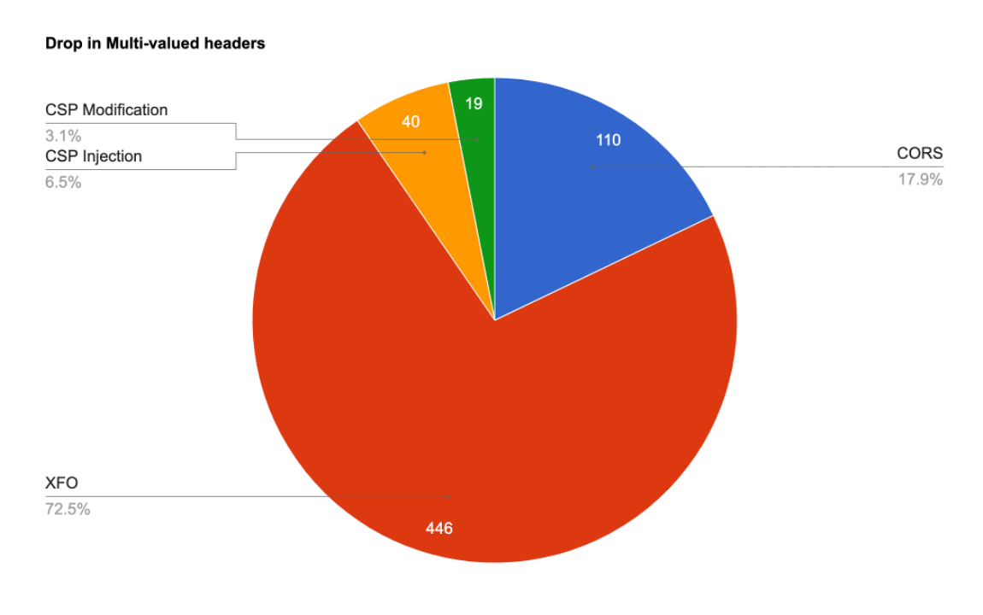
Security Impact – Multi valued headers
Cross-Origin Resource Sharing (CORS)
X-Frame options (XFO)
Content-Security-Policy (CSP)
Notes:
This study investigates the longitudinal evolution of Chrome extensions that modify security headers over 19 months. The study found that many extensions added new features that required relaxed security restrictions imposed by CSP, XFO, and ACA-Origin. A significant number of extensions were removed from the store, but the vast majority were benign, and only a few were known to be malicious. The study suggests that newly added extensions make more excessive use of interception capabilities than older ones..
Famous extensions also violated these ethics to modify and alter headers
DuckDuckGo
Video Downloader for Vimeo
MarkDown Viewer
Over period these were either taken down or they updated their code to include relevant headers
It is becoming harder to judge whether new extensions make more excessive use of interception capabilities than older ones.

Slide 21

Discussion
Extensions Beyond Chrome & Standards
Framework for analyzing security behavior of browser extensions that modify HTTP headers
Applied to Chrome and easily adapted to Firefox

Slide 22
Discussion
Limitations
Does not inject hooks into external scripts in the background script
Does not create honeypages or simulate user interactions to capture any runtime checks
Results are a lower bound of the issue of extensions
Unlikely to catch malicious extensions on conditional triggers

Slide 23
Discussion
Call to Action
Inadvertent header modifications by extensions undermine user security.
Extension vetting process including an analysis pipeline to inform users of potential risks automatically.
The pipeline can be integrated into the vetting process for Google and Mozilla.

Slide 24

Conclusion
Browser extensions that modify security-related headers inadvertently
An automated framework was presented to identify such extensions and analyze them dynamically.
The pipeline used can be incorporated into store operators' vetting process to issue warnings automatically.

Slide 25
Thank You

